Slide 1

463.2
Social Networks
Computer Security II
CS463/ECE424
University of Illinois
Notes:
Based on earlier slides developed by Ravinder Shankesi

Slide 2
Overview
Homophily in Social Networks
Social Network Inference
Privacy Risks
Discussion

Slide 3
463.2.1 Homophily in Social Networks
Notes:
Based on earlier slides on Social Networks

Slide 4
Homophily
Wikipedia: Homophily (i.e., "love of the same") is the tendency of individuals to associate and bond with similar others.
  Term coined in 1950s in sociology papers.
Systematically studied even earlier
Much older concept. Socrates to Lysis:
  “And have you not also met with the treatises of philosophers who say that like must love like?”
Modern variant: ‘Similarity breeds connection’
Notes:
[1]: Birds of a feather: Homophily in Social Networks
Annual Review of Sociology
Vol. 27: 415-444 (Volume publication date August 2001)
Miller McPherson, Lynn Smith-Lovin , and James M Cook

Slide 5
Homophily
Shown to exist for many attributes
  Race/Ethnicity
  Age
  Religion
  Education
  Occupation
  Gender
  Marriage (homogamy)
Socrates (again) speaking to a pair of youths:
I shall not ask which is the richer of the two, I said; for you are friends, are you not?
Certainly, they replied.
And friends have all things in common, so that one of you can be no richer than the other, if you say truly that you are friends.
They assented.
Notes:
But Plato’s point is more subtle. Here is a fuller passage from Lysis, the Plato dialog on friendship. The dialog here is between Socrates and Lysis:
God is ever drawing like towards like, and
making them acquainted. I dare say that you have heard those words.
Yes, he said; I have.
And have you not also met with the treatises of philosophers who say that like must love like? they are the people who argue and write about nature and the universe.
Very true, he replied.
And are they right in saying this?
They may be.
Perhaps, I said, about half, or possibly, altogether, right, if their meaning were rightly apprehended by us. For the more a bad man has to do with a bad man, and the more nearly he is brought into contact with him, the more he will be likely to hate him, for he injures him; and injurer and injured cannot be friends. Is not that true?
Yes, he said.
Then one half of the saying is untrue, if the wicked are like one another?

Slide 6
Homophily: Terminology
Choice Homophily
Induced Homophily
Closeness due to preferences by the individual.
Example: Favorite teams
Closeness due to other constraints.
Examples: Geographic closeness, Age closeness with friends.
Value Homophily
Status Homophily
Individuals with similar values, thinking.
Example: Religion
Individual with similar social status.
Example: Aristocracy

Slide 7
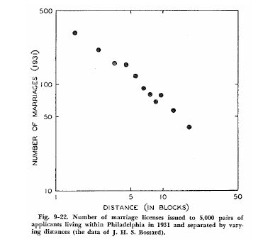
Geographic Homophily: Marriages
George Zipf, studied a large number of such empirical relationships
Is this (inverse) relationship independent of other factors?
# Marriages
# Blocks Distance
Notes:
Zipf is more famous for his Zipf’s law which shows up in a surprising number of places.
“Human behavior and the principle of least effort” George Zipf, 1949

Slide 8
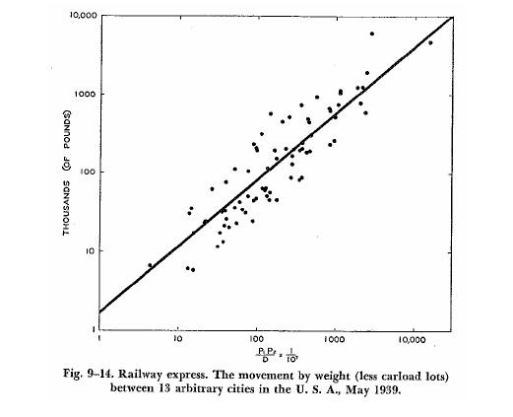
Geographic Homophily
Size and distance of populations correlate with their degree of connection.
Zipf equation:
Connection =
G * ( (Pop1 * Pop2) / Distance )
Scaling factor G
Notes:
George Zipf: The P1 P2/D hypothesis: on the intercity movement of persons
American Sociological Review, Vol. 11, No. 6. (1946)

Slide 9
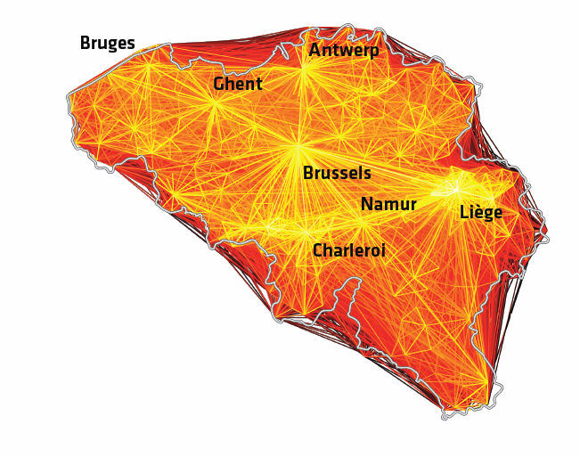
Geographic Homophily:
Telephone Call Graphs in Belgium
Notes:
Urban Gravity: a Model for Intercity Telecommunication flows

Slide 10
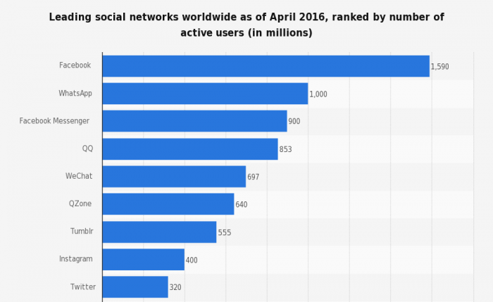
Social Network Size
Notes:
http://www.smartinsights.com/social-media-marketing/social-media-strategy/new-global-social-media-research

Slide 11
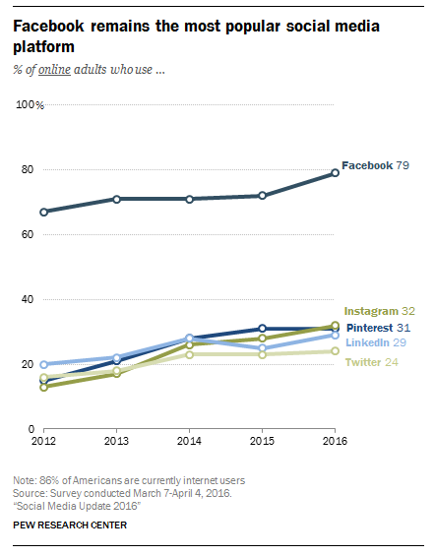
Popularity Trends
Notes:
http://www.pewinternet.org/2016/11/11/social-media-update-2016/pi_2016-11-11_social-media-update_0-01

Slide 12
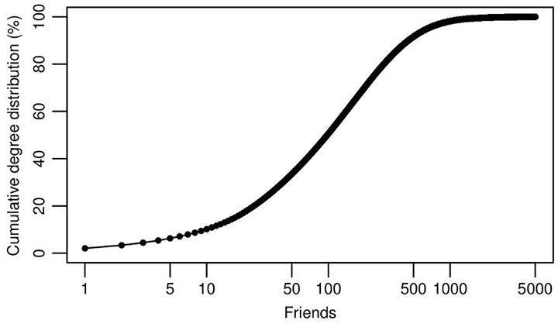
Numbers of Friends on Facebook
Data from 2011 (721 million users)
More than half have more than 100 friends
Notes:
Anatomy of Facebook
https://www.facebook.com/notes/facebook-data-team/anatomy-of-facebook/10150388519243859

Slide 13
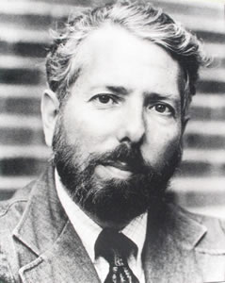
Milgram’s Six Degrees of Separation
Milgram (1967)
The Six Degrees of Separation
experiment:
Random people from Nebraska were to send a letter (via intermediaries) to a stock broker in Boston.
Could only send to someone with whom they were on a first-name basis.
Among the letters that found the target, the average number of links was six.
Stanley Milgram (1933-1984)
Notes:
Milgram was a brilliant psychologist, notorious for his studies of obedience, where subjects continued to deliver what they believed to be painful electric shocks, just because a person in a lab coat told them they should do so as part of an experiment.
Note on the small-worlds experiment:
– Not many of the letters in the original experiment arrived.
-- The experiment presaged some later discoveries, including hubs, tendency to go by geography and profession, etc.

Slide 14
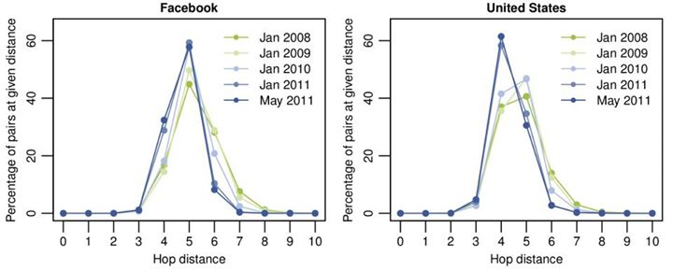
Degree of Separation on Facebook
Facebook users had 4.74 degrees of separation in 2011 (down from 5.28 in 2008)
Notes:
Anatomy of Facebook
https://www.facebook.com/notes/facebook-data-team/anatomy-of-facebook/10150388519243859

Slide 15
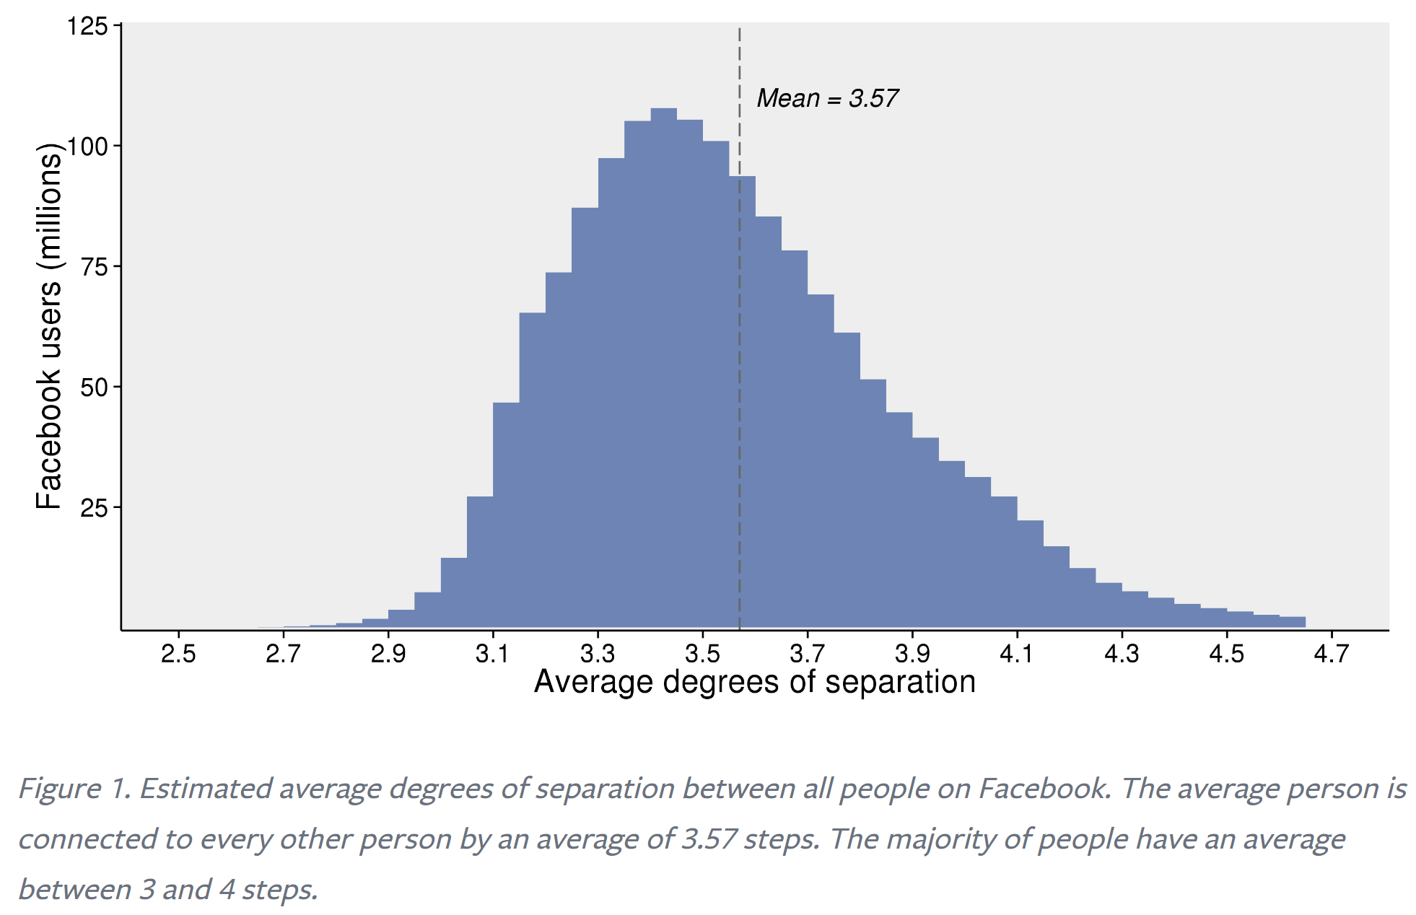
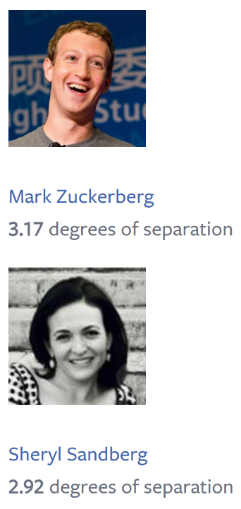
Recent Degree of Separation for Facebook
Notes:
https://research.fb.com/three-and-a-half-degrees-of-separation/

Slide 16
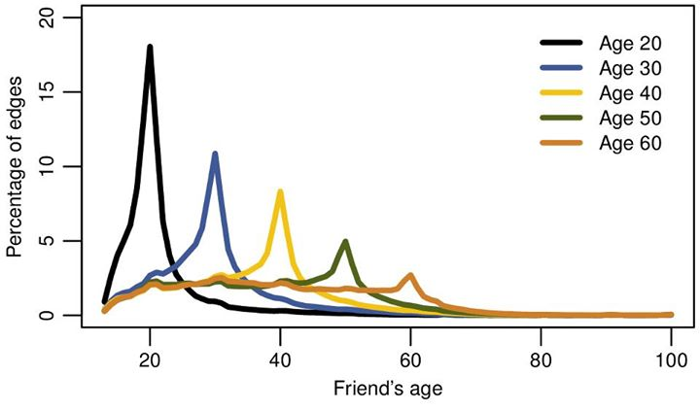
Homophily on Facebook
84% of all connections are within same country
Ages on Facebook in 2011 show homophily

Slide 17


Slide 18
463.2.2 Attribute Inference in Social Networks
Notes:
Based on earlier slides on Social Networks

Slide 19
Social Networks: Inference
It is understood by a user of a social network, that the provider (such as Facebook, Google-plus) will have profile data given by the user.
  This privacy risk is ‘implicitly’ acceptable to the user.
However
  Can the provider infer other attributes about you?
  What can a third party infer from ‘publicly’ disclosed attributes?

Slide 20
Social Networks: Age Inference
[Dey12] Estimating Age Privacy Leakage in Online Social Networks (INFOCOM 2012)
  Used 1.4 million users in New York City (along with 49.2 million friends)
  Attempted to estimate age of a user
  Had ground truth available due to Facebook’s policies in 2009, but only 1.5% of ages were public in 2010.
What attributes (other than age itself) would be most helpful for this inference?
[Dey12]
Notes:
Ratan Dey, Cong Tang, Keith W. Ross, Nitesh Saxena: Estimating age privacy leakage in online social networks. INFOCOM 2012:

Slide 21
Social Networks: Age Inference
Use the property of age-homophily
  Ages of friends should be similar to that of the user
  High-school graduation year of friends should be closer to the high-school graduation of the user
  Use information from friends of friends, etc.,
What if the user has not made their friend list public?

Slide 22
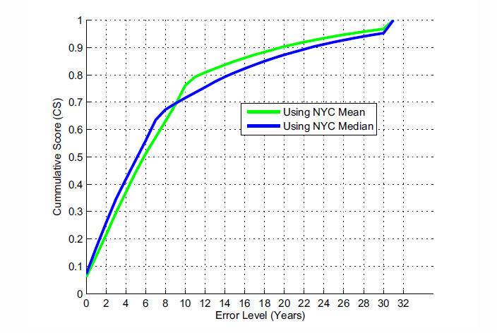
Social Networks: Age Inference
As a baseline, take the mean / median of the known ages in the whole dataset as the age estimate
  The cumulative score (y-axis) shows the percentile of users whose estimate was within the error level (x-axis)

Slide 23

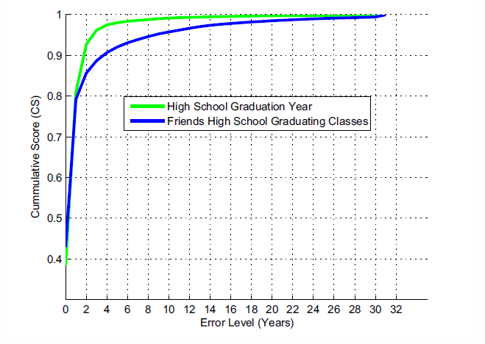
Social Networks: Age Inference
With known high-school graduation year (HSY), age pairs
  Train a linear-regression model for Birth Year (BY)
    For instance, if you graduated from high-school in 1980, the birth year comes to 1963
  If HSY is not available, use most frequent friends’ HSY (with a minimum threshold).
Notes:
If you know the HSY then use the linear regression equation to predict BY (green). If not, look at the HSYs for the friends and use those to estimate HSY, then use that to estimate BY (blue). The latter yields better coverage at the cost of lower accuracy.

Slide 24
Social Networks: Age Inference
First Phase:
  Known ages
  If HSY available, estimated ages from HSY
  If enough friends with HSY available, Estimated ages from HSY of friends
Not all users satisfy one of the above three conditions: For those, use iterative approach
  estimated age of friends in the previous step
  Iteratively do this multiple times, to gradually cover the entire graph

Slide 25
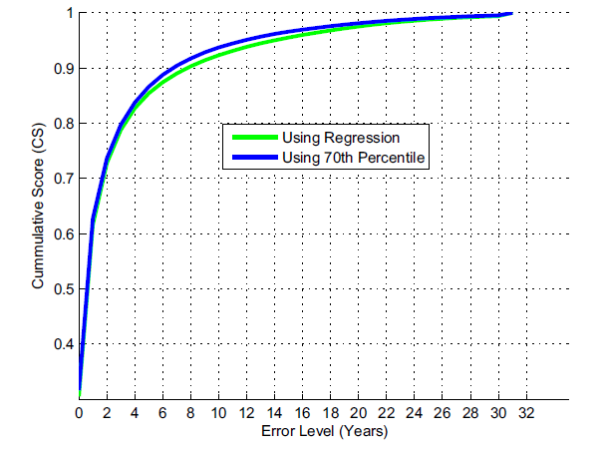
Social Networks: Age Inference
Using the iterative approach, 83.8% of user ages can be identified within age error bound of 4 years
Notes:
For the percentile approach, with a given value of q, [·]
is simply the q percentile of the ages in Fu(i). For example,
with q = 70, we take the age x for which 70% of the users
in Fu(i) are younger than x. Note that q = 50 is simply the
median of the ages in Fu(i). We experimented with using
different percentiles such as 50th (median), 60th, 70th, 80th
etc and found that 70th percentile provided the best estimation
accuracy in terms of MAE and CS.

Slide 26
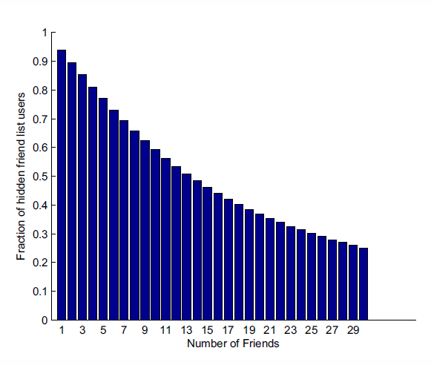
Social Networks: Age Inference
What if a user’s friend list is not publicly listed?
Use reverse look up:
Fraction of hidden friend list users for whom reverse lookup can identify x number of friends
Notes:
The figure shows
the fraction of users among those hiding their friend lists for
which reverse lookup can identify x friends. For example, for
46.3% of these users we can find at least 15 (NYC) friends.
Clearly, with a more extensive crawl, which would also obtain
the friend lists of the non-NYC users, reverse lookup would
yield a much more complete view of these otherwise hidden
friend lists.

Slide 27
More sophisticated inferences
[Mislove10] “You are who you know: Inferring user profiles in online social networks” (WSDM 2010)
  Big idea: perform community detection
    Users are clustered around attribute-based communities
    Hence, if we find communities, we can infer attributes for users who do not share attributes, based on the fraction of users who do
[Mislove10]
Notes:
Alan Mislove, Bimal Viswanath, Krishna P. Gummadi, and Peter Druschel. 2010. You are who you know: inferring user profiles in online social networks. In Proceedings of the third ACM international conference on Web search and data mining (WSDM '10). ACM, New York, NY, USA, 251-260. DOI=10.1145/1718487.1718519 http://doi.acm.org/10.1145/1718487.1718519

Slide 28
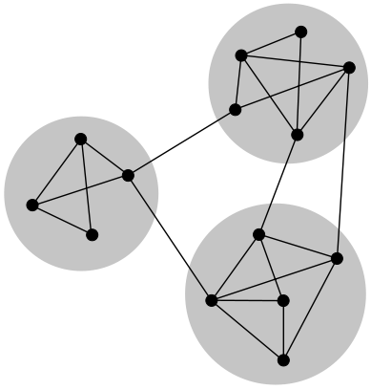
Community Detection
Inter-community edges more common than intra-community edges (more than expected by, say, a random distribution of edges).
  Sample algorithm: remove edges that are on the most number of shortest paths between any two vertices
Notes:
Image taken from Wikipedia

Slide 29
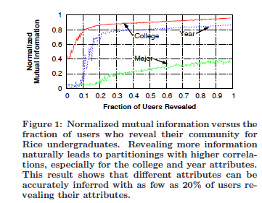
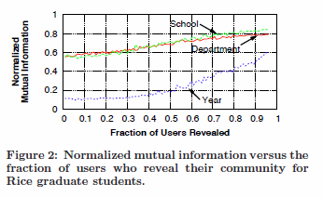
Community Detection: Results

Slide 30
More sophisticated inferences
[Thomas10] “unFriendly: Multi-party Privacy Risks in Social Networks”. Privacy Enhancing Technologies 2010
  Privacy can be lost because your friends may have different, laxer, disclosure policy. Use the most restrictive of the pair.
Inference:
  Don’t just use friend-links, but also weight friends (based on activity, number of mutual friends)
  Use wall content text, to further classify users.
[Thomas10]
Notes:
Kurt Thomas, Chris Grier, David M. Nicol: unFriendly: Multi-party Privacy Risks in Social Networks. Privacy Enhancing Technologies 2010: 236-252

Slide 31
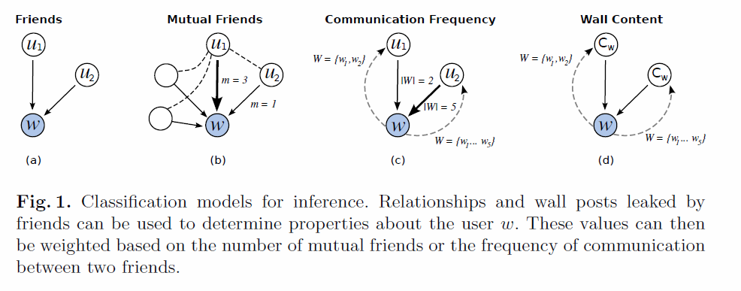
Unfriendly: Inference models

Slide 32
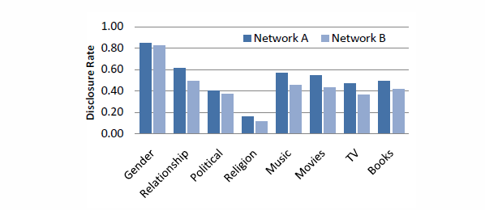
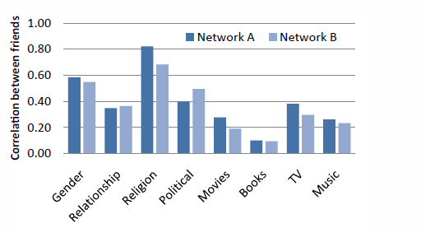
Unfriendly: Attribute Disclosure versus Attribute Correlation

Slide 33
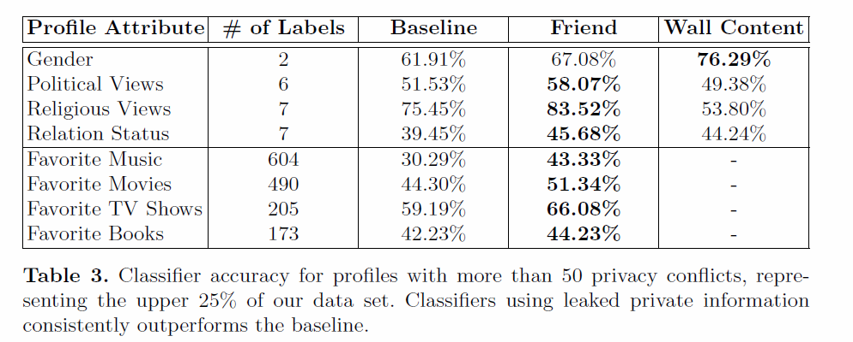
Unfriendly: Inference results

Slide 35
463.2.3 Privacy Risks
Notes:
Based on earlier slides on Social Networks

Slide 36
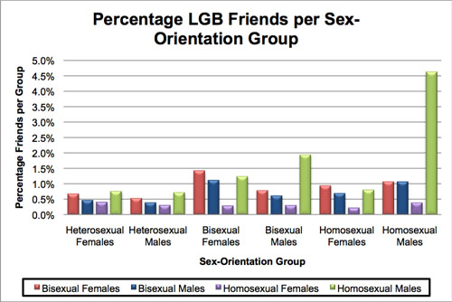
Privacy Risks: Attribute Disclosure
Gaydar: Facebook friendships expose sexual orientation

Slide 37
Privacy Risks:
New breed of lenders use Facebook and Twitter data to judge borrowers
  “It’s the whole mantra, birds of a feather tend to flock together. And if you tend to connect with people who are high risk or higher risk borrowers, then the perception is that you are as well. And that’s really where the issue lies.”
Some startups have advocated using it to approve loans to otherwise risky borrowers
Notes:
New breed of lenders use Facebook and Twitter data to judge borrowers
https://gigaom.com/2014/01/09/new-breed-of-lenders-use-facebook-and-twitter-data-to-judge-borrowers/

Slide 38
Privacy Risks:
“I’m fine. I don’t have a Facebook account”
Shadow Profiles:
  Based on data uploaded by other users
  Information about a shadow profile can be updated over time
Notes:
http://www.digitaltrends.com/social-media/what-exactly-is-a-facebook-shadow-profile/

Slide 40
Reading
[Dey12] Dey, Ratan, Cong Tang, Keith Ross, and Nitesh Saxena. "Estimating age privacy leakage in online social networks." In INFOCOM, 2012.
[Mislove10] Mislove, Alan, Bimal Viswanath, Krishna P. Gummadi, and Peter Druschel. "You are who you know: inferring user profiles in online social networks." In WSDM 2010.
[Thomas10] Thomas, Kurt, Chris Grier, and David M. Nicol. "unfriendly: Multi-party privacy risks in social networks." In PETS 2010.

Slide 41
Discussion Questions
How can social networks be best used by advertisers? (Think like an advertiser or social network vendor.)
Are there alternative approaches to social networking that may limit inference of attributes about users?
(Consider architecture, business models, regulation, etc.)

